Slide 1
Identifying Covid-19 patients from Chest X-Rays
Kester chia

Slide 2
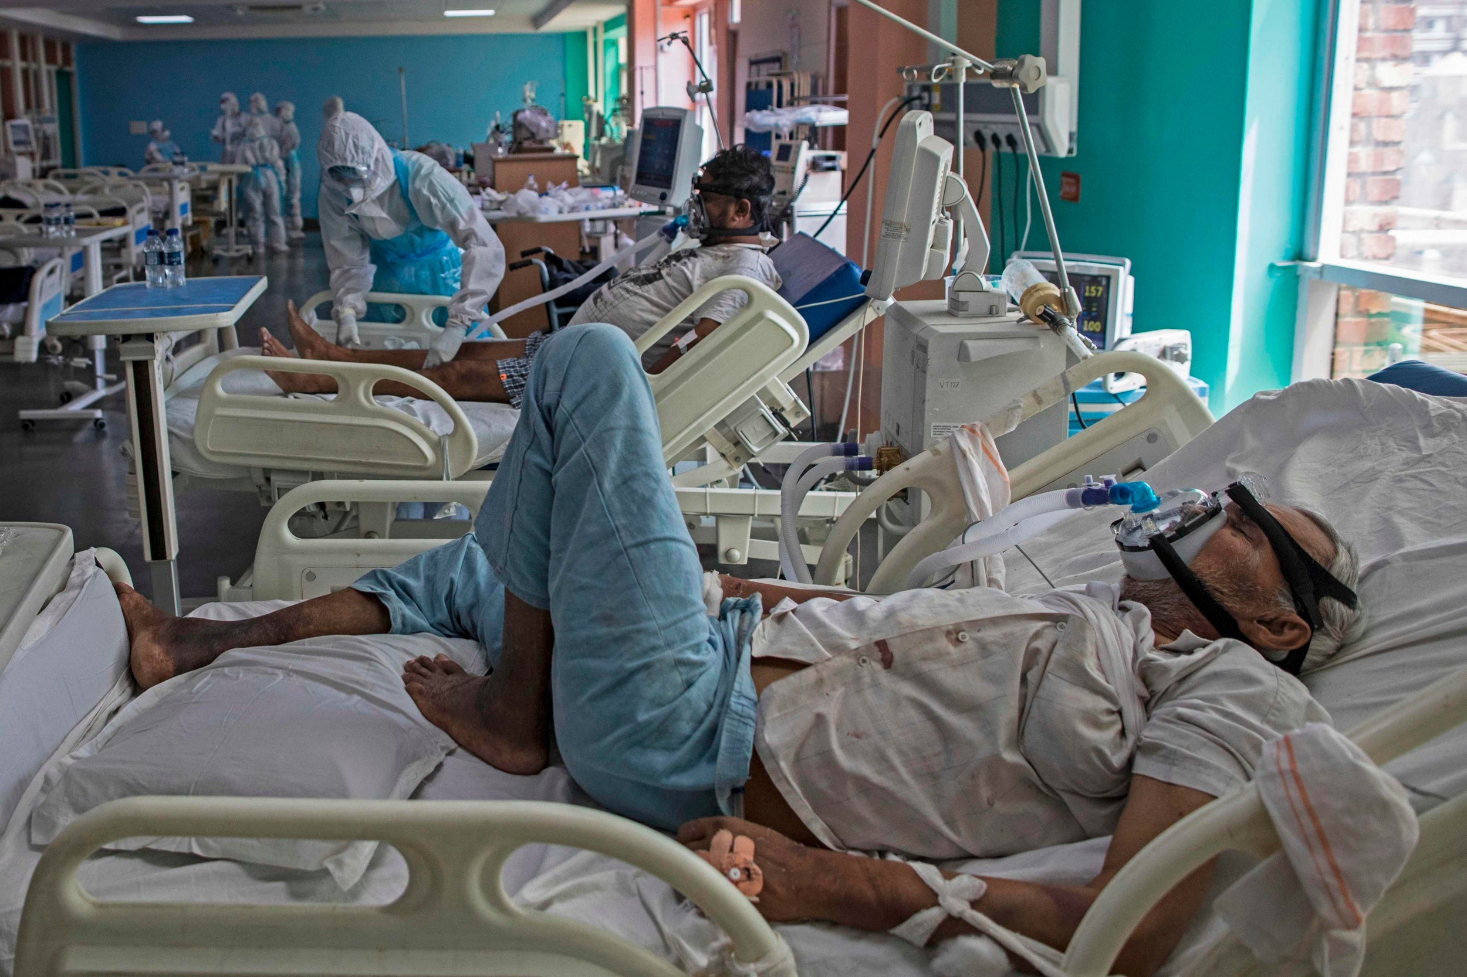
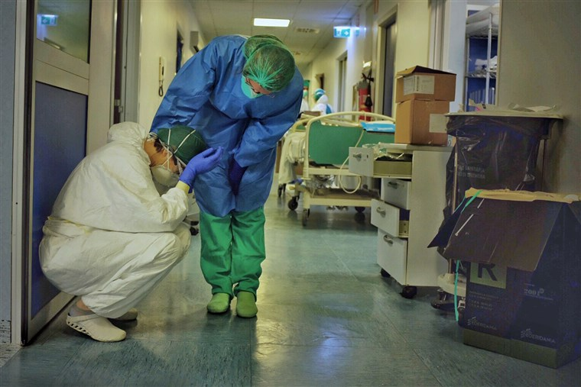
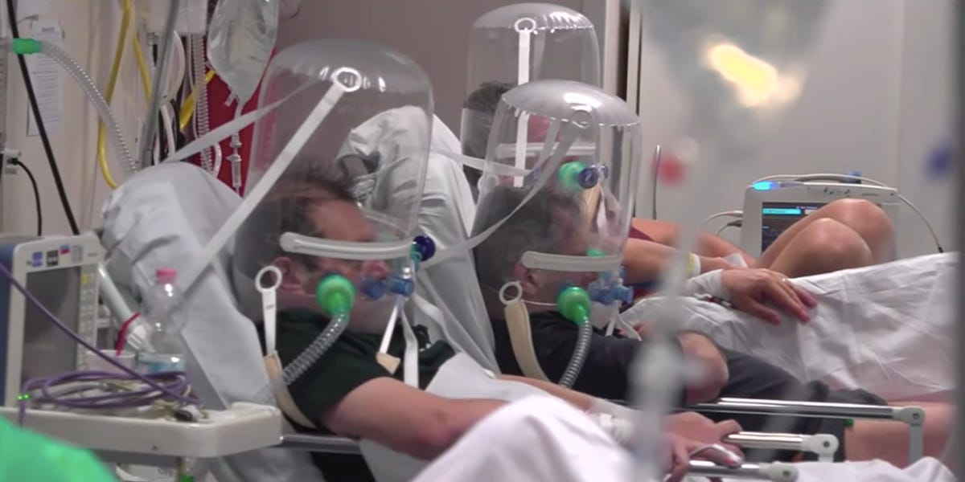
Overwhelmed Hospitals
Notes:
Sources:
https://www.nbcnews.com/health/health-news/italy-has-world-class-health-system-coronavirus-has-pushed-it-n1162786
https://www.independent.co.uk/news/world/asia/india-coronavirus-cases-deaths-million-covid-latest-a9623821.html

Slide 3
Building a model to detect infections from Chest X-Rays
Detect
Detect presence of infection, as well as type (Viral/Bacterial)
Streamline
Streamline case detection and save hospital resources
Relieve
Relieve burden on healthcare systems

Slide 4
Dataset
We will be using a dataset containing Chest X-Rays of patients.
The dataset was downloaded from Kaggle: https://www.kaggle.com/praveengovi/coronahack-chest-xraydataset
The dataset contains ~5800 jpeg images of Chest X-Rays of Healthy patients, as well as patients affected with Pneumonia. The pneumonia X-Rays contain cases of bacterial infections as well as viral infections, such as SARS (Severe Acute Respiratory Syndrome ) ,Streptococcus & ARDS (Acute Respiratory Distress Syndrome).

Slide 5
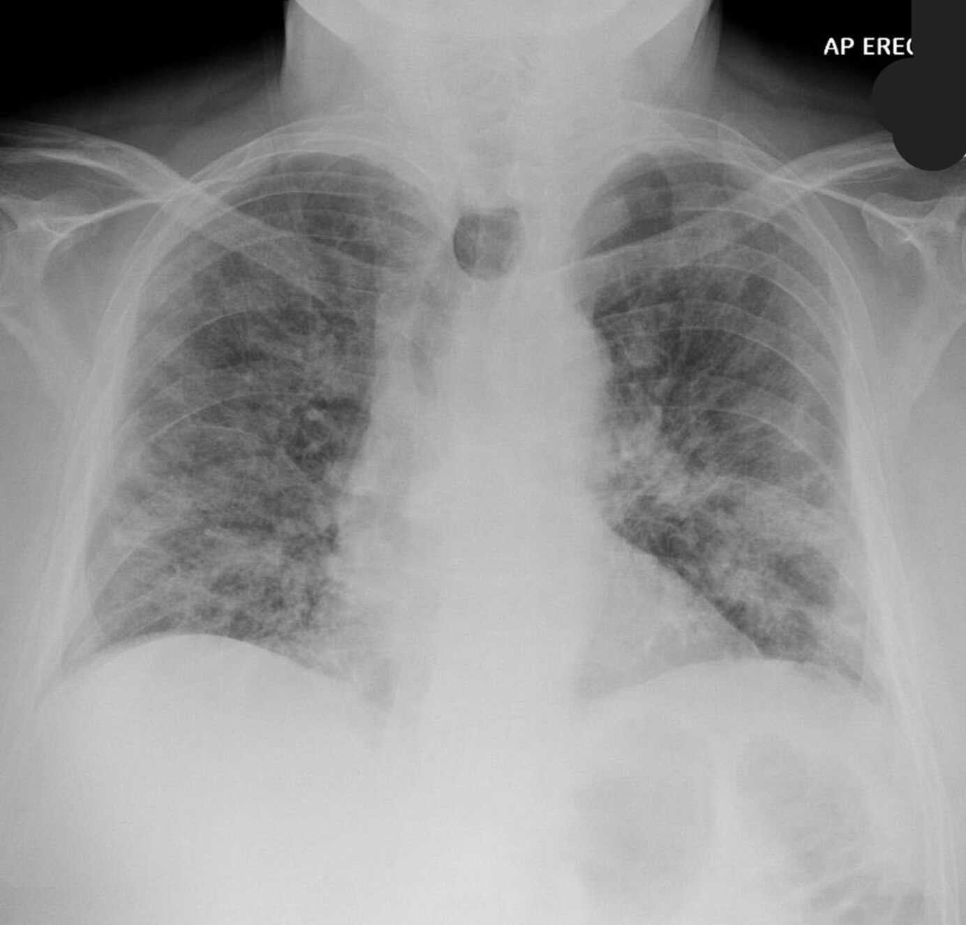
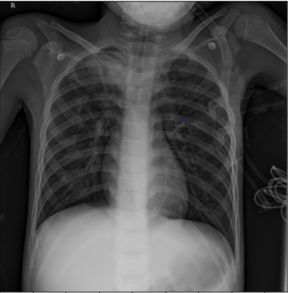
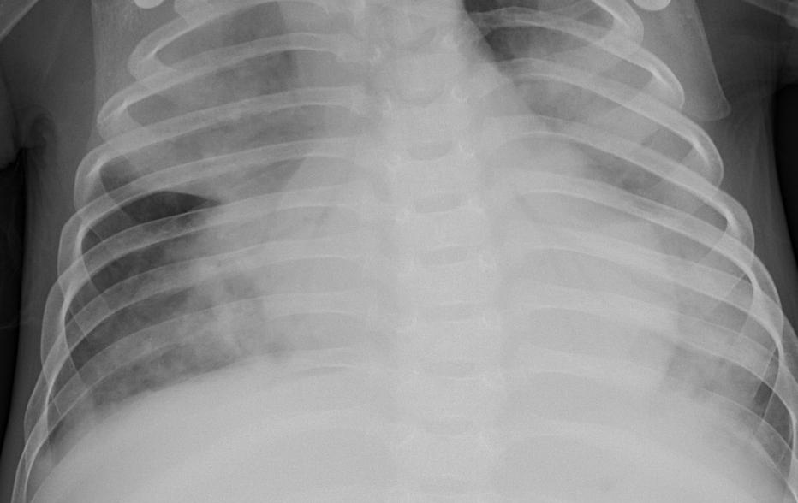
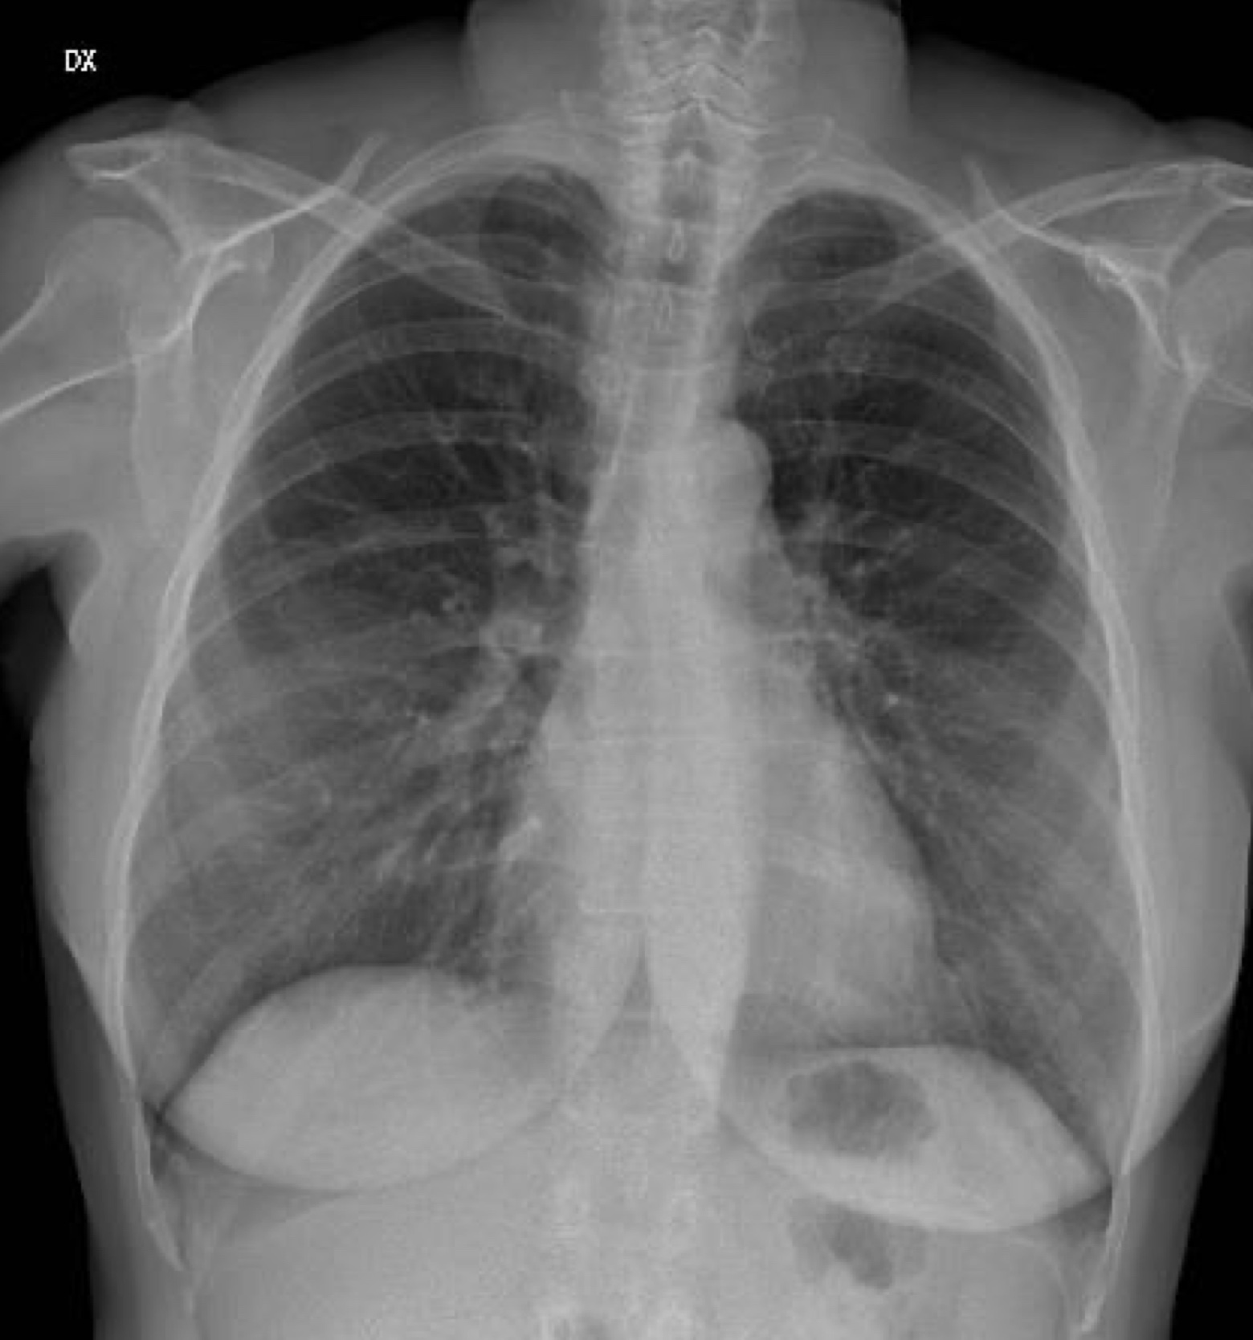
Chest X-Rays
Covid-19
Viral (Non-Covid)
Bacterial
Healthy
Notes:
Sources:
https://www.latimes.com/world-nation/story/2020-05-13/in-wuhan-new-coronavirus-infections-spark-mass-testing-renewed-restrictions-and-residents-worries

Slide 6
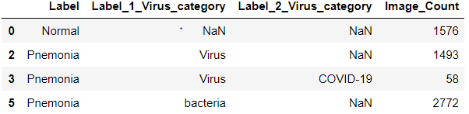
Dataset summary
The dataset is very imbalanced, with only 58 images for the Covid-19 class.
We address this issue by image augmentation and implementing class weights.

Slide 7
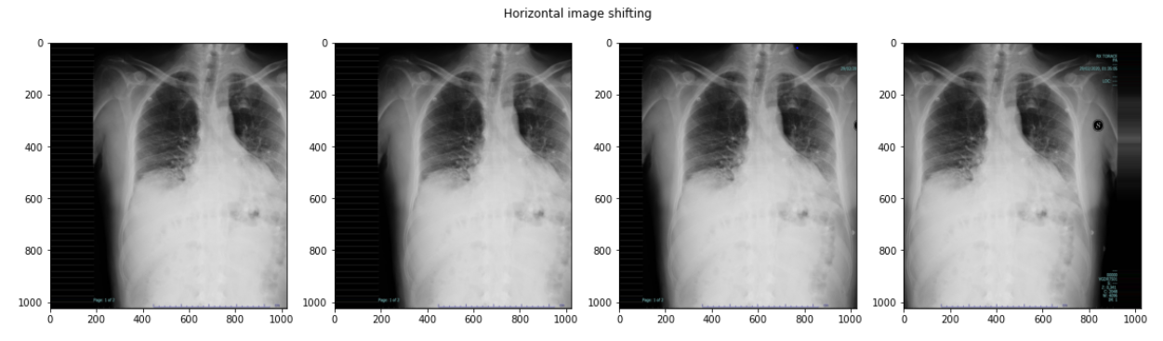
Image augmentation: Horizontal shifting

Slide 8
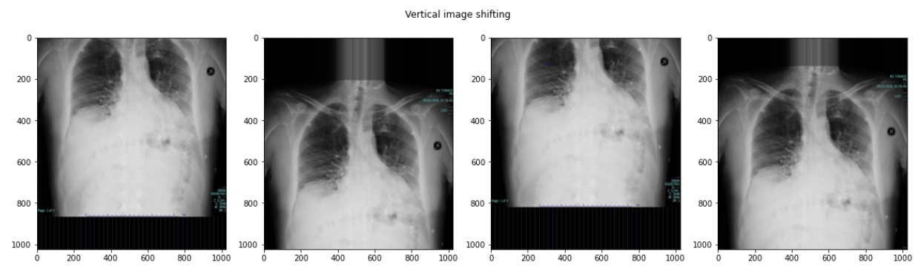
Image augmentation: Vertical Shifting

Slide 9
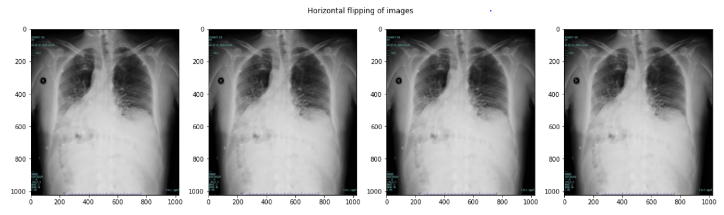
Image augmentation: Lateral inversion

Slide 10
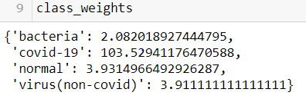
Class weights
Class weights are calculated as a simple inverse of (class count / total count).
Covid-19 classified X-Rays are given significantly higher weights in this approach.

Slide 11
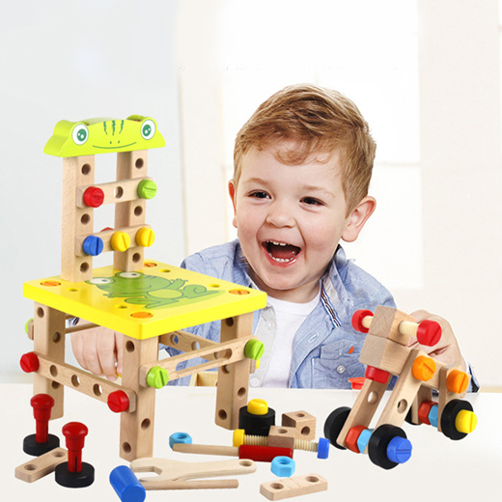
Building a model

Slide 12
Model choice: Convolutional neural network
Commonly used for image classification problems
Well established CNN architectures available to use as a starting point, instead of starting from scratch (LeNet-5, AlexNet, VGG etc.)
Images are not sequential, therefore Recurrent Neural Networks (RNNs) are not relevant

Slide 13
Model parameter choices:
Optimizer:
Adam was used as the optimizer, which sets per-parameter learning rates based on gradient functions
Scheduler:
On top of the Adam adjustments, the base learning rate was set to a reciprocal decay as epochs increased
Class weights:
Assigned as previously mentioned

Slide 14
Keras tuner
The Keras Tuner library was also used for hyperparameter tuning
Hyperparameters tuned:
Convolution size
Number of filters
Base learning rate for Adam optimizer
Number of units in Dense layer

Slide 15
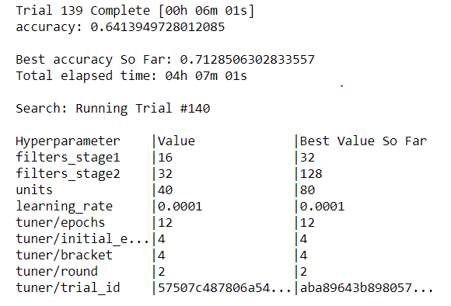

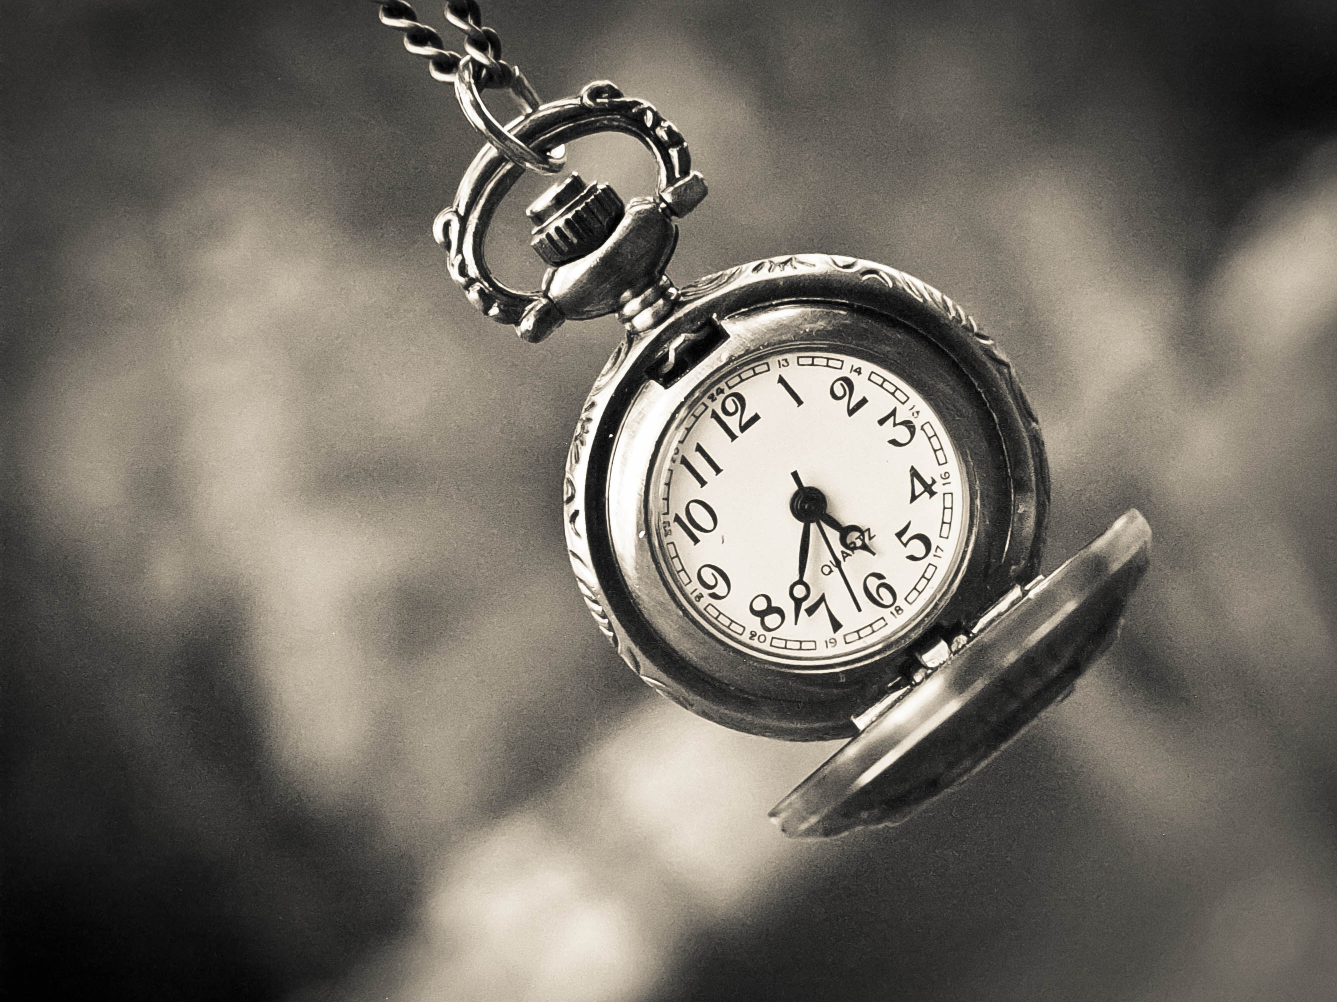
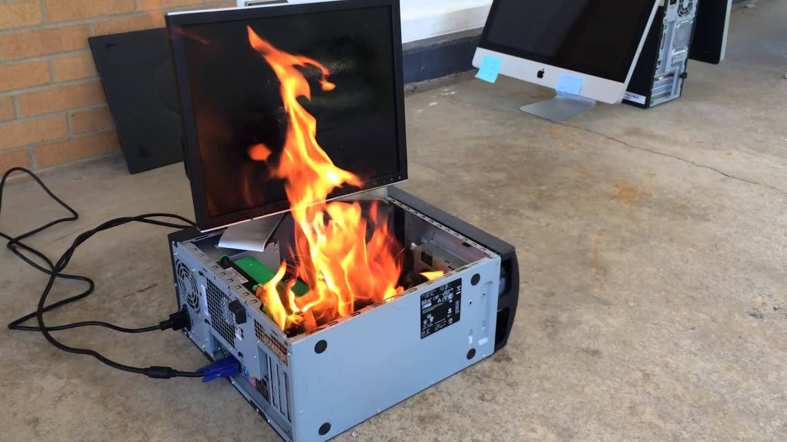
Tuning and Training the model:

Slide 16
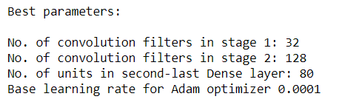
Tuning results
Stage 1 consists of 2 convolution layers
Stage 2 consists of 1 convolution layer

Slide 17
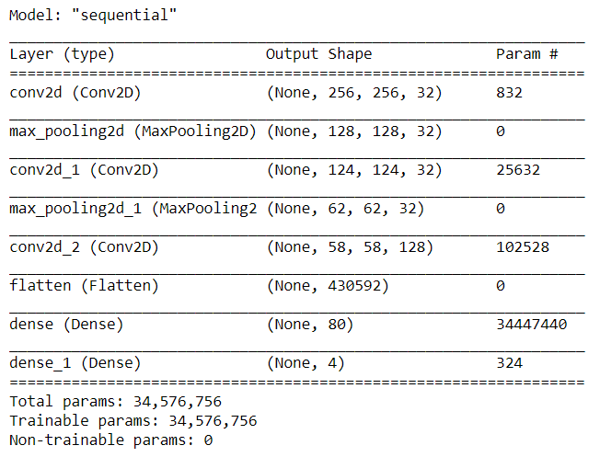
Final model architecture
Deep architectures were attempted (VGG, AlexNet) but couldn’t seem to achieve higher accuracies.
After removing some layers, the final network is shallow with only 3 convolution layers and 2 pooling layers (Max pooling), with the last dense layer for the final classification output.
Stage 1
Stage 2

Slide 18
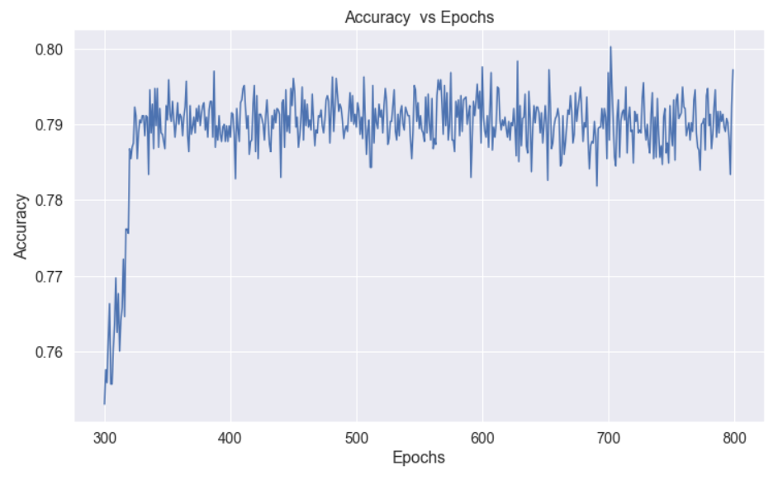
Evaluation
Model stagnates around 0.79 accuracy, after ~350 epochs

Slide 19
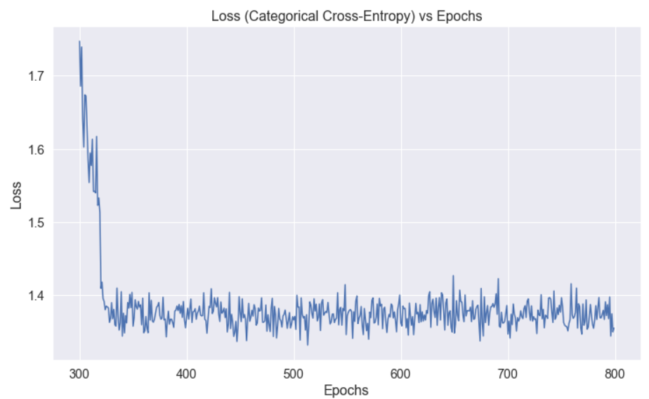
Evaluation
Similarly, loss function also converges after ~350 epochs

Slide 20
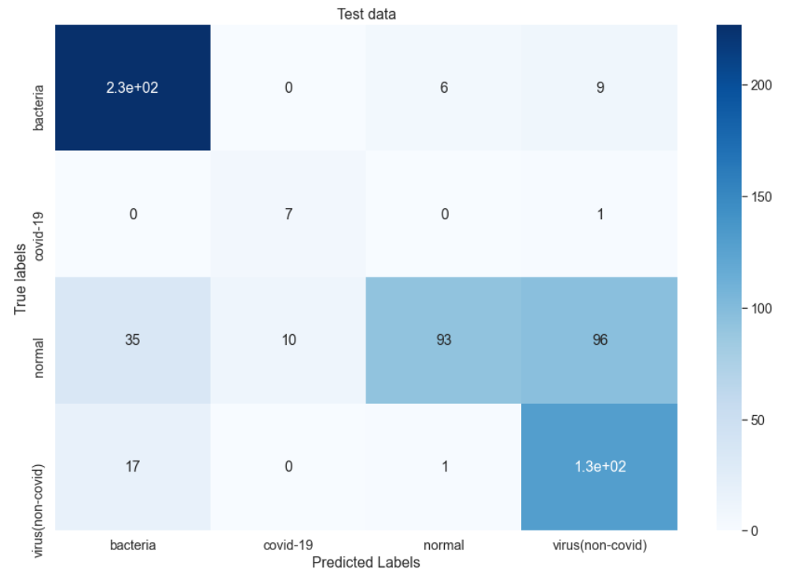
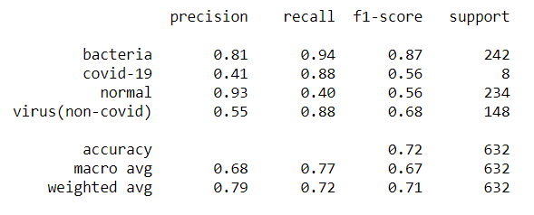
Evaluation
Model successfully picked up almost all covid-19 images with an 0.88 recall rate
Was precise on normal predictions, but also missed many

Slide 21
Evaluation
Model frequently identified viral (non-covid) infections as normal
Extremely high recall rate for bacterial infections

Slide 22
Practical use
Since the recall rate is high for Covid-19 images but precision is low, a high false positive rate should be expected in practical settings. This is probably due to the much higher class weight assigned to the Covid-19 labels during training.
The recall rate for healthy patients is decent at 0.93, so model can be used as a supplementary tool to detect if patients have recovered
The model also never misinterpreted a bacterial infection as a Covid-19 infection and vice versa. It could be a reliable tool for separating bacterial pneumonia cases from coronavirus cases.

Slide 23
Weaknesses / Future improvements
Adjustments in class weights can be made to prevent misidentification of viral (non-covid) images as healthy images
No data on the length of covid-19 infection; clouding (infected tissue) may be more visible on patients who have been infected for a longer period of time

Slide 24
end

